Slide 1

Computer
A programmable electronic machine that performs high-speed mathematical or logical operations or that assembles, stores, correlates, or otherwise processes information.

Slide 2

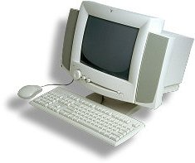
Computer Hardware

Slide 3
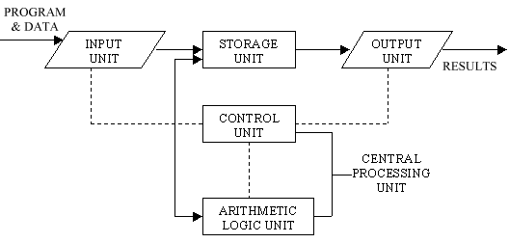
The Basic Structure of A Computer System Consists of Three Parts
1. CPU
Performs arithmetic and logic operations
2. INPUT – OUTPUT DEVICES
Keyboard, Monitor, Modem, Mouse, Joystick, Speakers, Printers, etc.
3. MEMORY
Primary – directly accessible by the CPU.
Secondary – external memory for storing data.
(Peripherals)

Slide 4
Computer Hardware
The physical components of a computer system, such as the circuit boards, chassis, enclosures, peripherals, cables, etc.
It does not include data or computer programs.

Slide 5
Overview of Computer Hardware
Motherboard
CPU
RAM
Harddisk
CD-ROM
Floppy Disk
Display Card
Sound Card
LAN Card

Slide 6
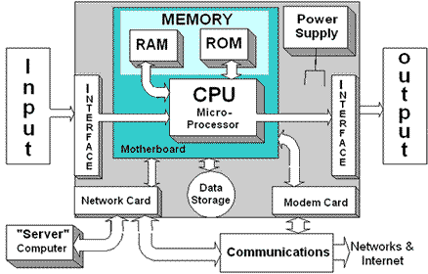
Computer Diagram
The Block Diagram as shown below is a representation of the fundamental pieces of any computer system. So whether it is a PC or MAC or some other type of computer it will have most if not all of these components.

Slide 7
Main Memory
Storage media installed on the motherboard
store data and instruction to be executed by the CPU
Main memory is classified into
RAM
ROM
CMOS

Slide 8
ROM
ROM – Read Only Memory
ROM is non-volatile
Data are stored permanently
Data can only be read but cannot be changed
Store instructions and tells the computer how to load the operations system when booting up
Basic Input/Output System (BIOS)

Slide 9
CMOS
Complementary Metal Oxide
holds information about the system and its peripherals even while the system is powered off
example the user set value on the clock is retained even after the power is turned off

Slide 10
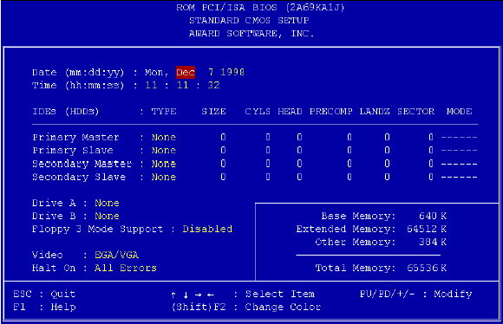
CMOS
CMOS - Complementary Metal-Oxide Semiconductor Memory
It has the characteristics of both ROM and RAM, ie:
it is non-volatile
information in CMOS can be changed
In computer, CMOS stores the configuration information about a computer like capacity of the hard disk and the current time and date.

Slide 11
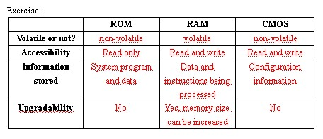

Slide 12
Computer Hardware
RAM | ROM
(Random Access Memory) Short term memory in a computer. When the computer is turned off, all the information stored here disappears. A memory device in which information can be accessed in any order. | (Read Only Memory) A small memory that allows fast access to permanently stored data but prevents addition to or modification of the data.

Slide 13
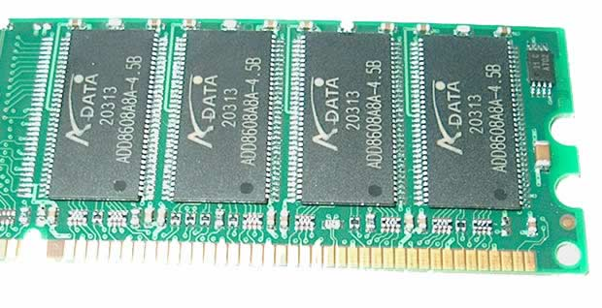
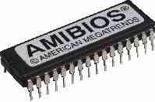
Computer Hardware
RAM
ROM

Slide 14
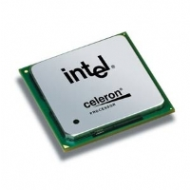
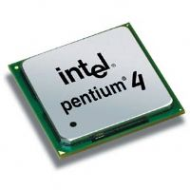
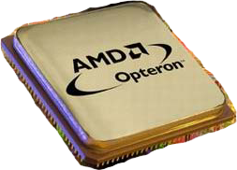
Computer Hardware
Central Processing Unit (CPU) or Microprocessor

Slide 15
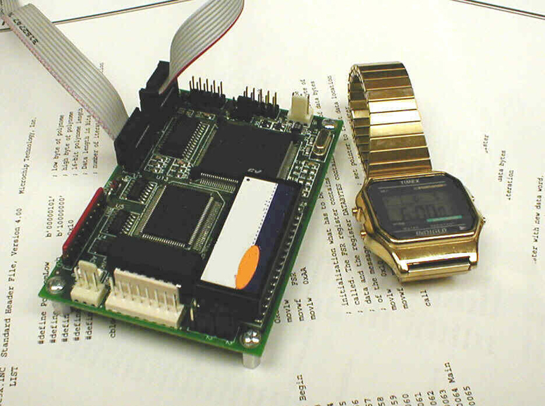
Central Processing Unit

Slide 16
CPU
A CPU consists of two parts, the ALU and the CU.
Both the ALU and the CU contains registers, which are
high-speed memory
temporarily hold data and instructions during processing.

Slide 17
CPU Performance depends on…
Clock rate
the speed at which the CPU can execute an instruction.
unit is Hertz (Hz).

Slide 18
CPU Performance depends on…
Cache Memory
memory that is placed inside the CPU.
it is random access memory (RAM) that a microprocessor can access more quickly than it can access main memory.
acts as an intermediate between registers and the main memory.
it stores some frequently accessed data so it shorten the time of accessing the RAM.
increasing the size of the cache memory will greatly improve the overall performance of the computer system.

Slide 19
Different kind of CPU
Intel
Celeron
Pentium 4
Xeon
AMD
Duron
Athlon XP
Sempron
Athlon 64
Common features
Clock rate > 2GHz
Differences
Word Size
Cache Memory Size
Front Side Bus
No. of transistors

Slide 20
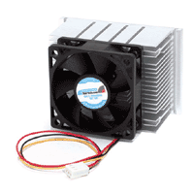
Computer Hardware
The CPU is usually protected from Heat by a Heatsink and Fan combination

Slide 21
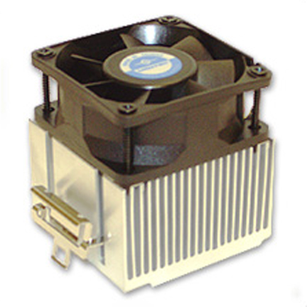
Fan and Heat Sink

Slide 22
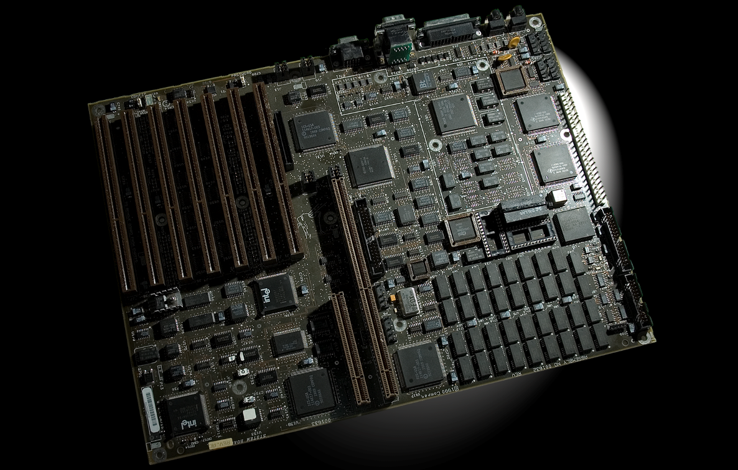
Motherboards

Slide 23
Overview
You will learn to
Explain how motherboards work
Identify the types of motherboards
Explain chipset varieties
Upgrade and install motherboards
Troubleshoot motherboard problems

Slide 24
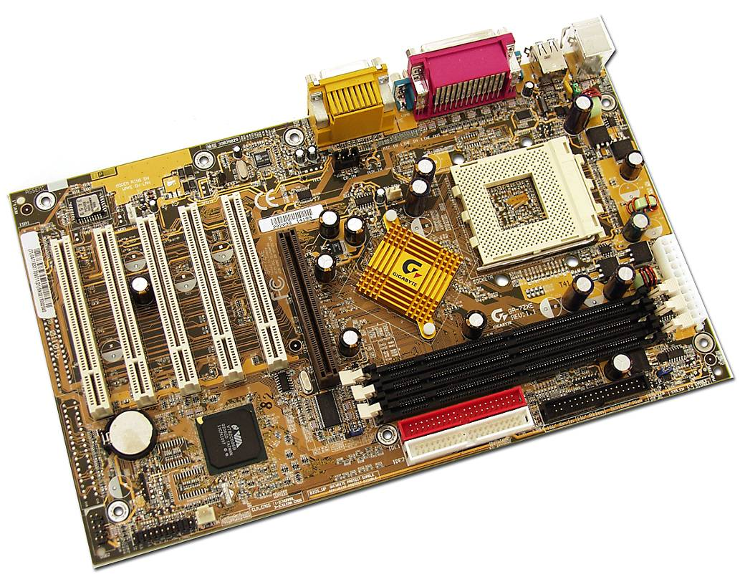
How Motherboards Work
Historical/Conceptual

Slide 25
Motherboard Characteristics
Form factor defines
Size of the motherboard
General location of components and parts
Chipset defines
Type of processor and RAM supported
Built-in components
With a built-in NIC, extra NIC not needed

Slide 26
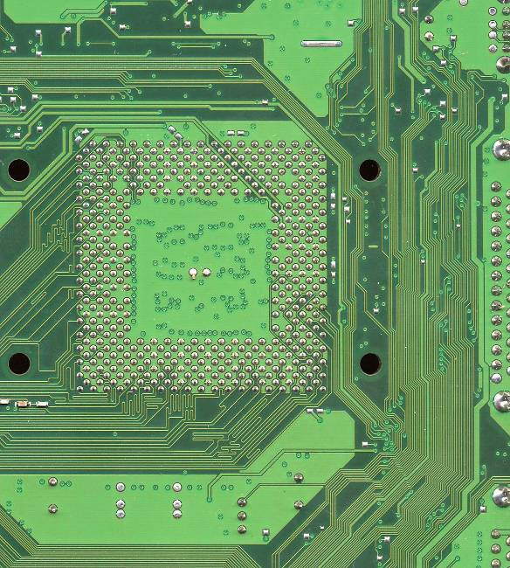
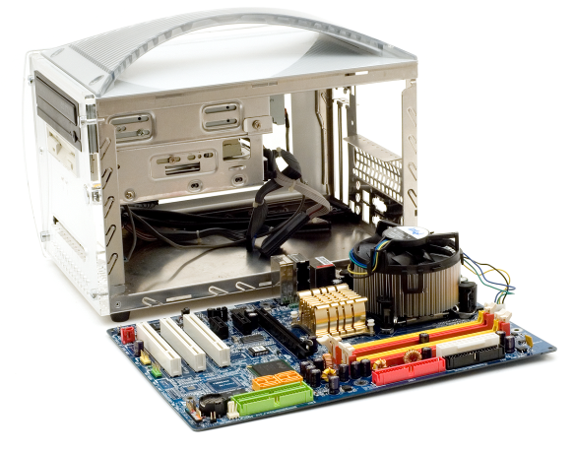
Layers of the PCB
Motherboards are officially printed circuit boards (PCBs)
PCBs come in multiple layers with highways of wires (bus systems) in the layers
These highways of wires are called traces
Boards are standardized so that they can fit in cases

Slide 27
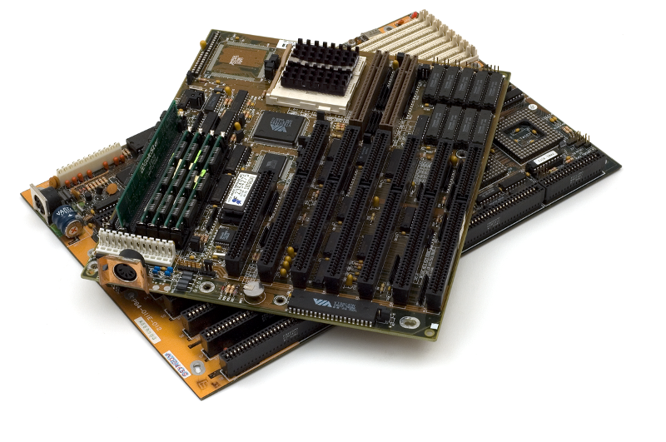
The AT Form Factor
IBM invented the AT form factor in the early ’80s
Lasted through mid ’90s
Currently obsolete
Large keyboard socket, split power socket (P8/P9)
Baby AT was smaller version
Alternatives were
LPX
NLX

Slide 28
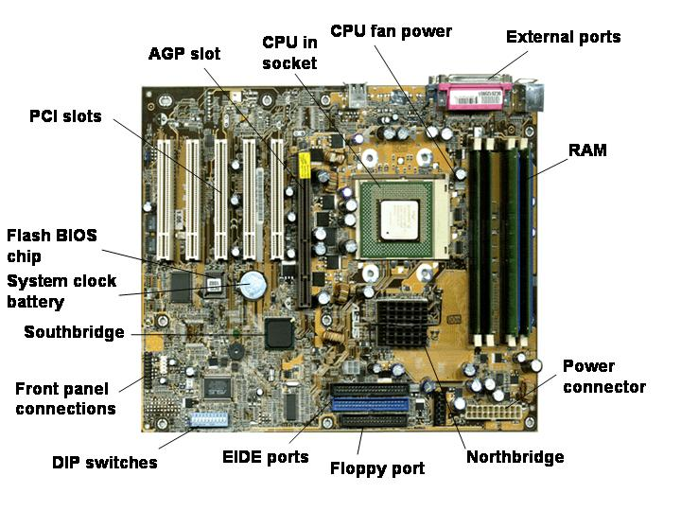
ATX Motherboard Parts
Notes:
Tech Tip
Soft power
ATX motherboards use a feature called soft power. This means that motherboards can use software to turn the PC on and off. The physical manifestation of soft power is the power switch. Instead of the thick power cord used in AT systems, an ATX power switch is little more than a pair of small wires leading to the motherboard.

Slide 29
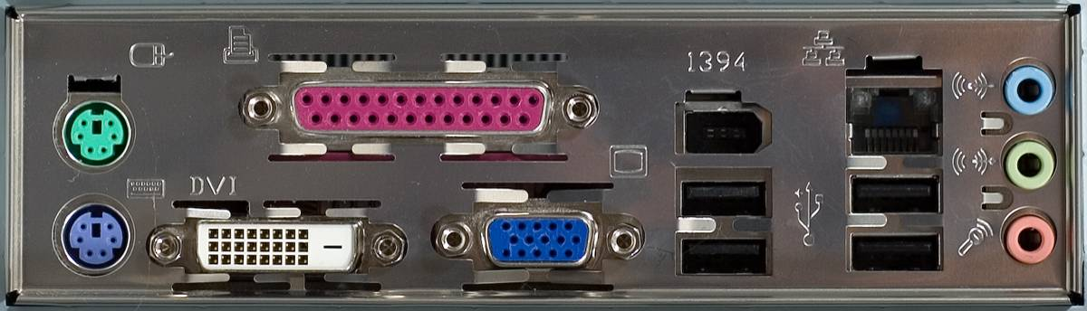
ATX Form Factor
Created in 1995
About same size as Baby AT
Had many ports accessible from rear of PC including mini-DIN
RAM was closer to Northbridge and CPU for better performance
Uses the soft power feature to turn PC on and off through software

Slide 30
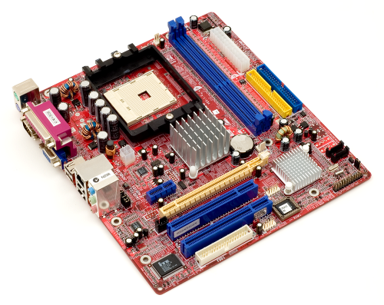
ATX Spin Offs
MicroATX and FlexATX two smaller versions of ATX
Many techs and Web sites use the term mini-ATX to describe these boards
Cases need to be matched to motherboards
Can’t put a larger motherboard into a smaller case
Case manufacturers have made accommodations for smaller motherboards in larger cases

Slide 31
ATX Spin-offs
BTX (Balanced Technology Extended)
Due to heat, cooler form factors needed
Three subtypes of BTX
BTX designed to replace ATX
microBTX designed to replace microATX
picoBTX designed to replace FlexATX
Proprietary form factors
Unique to a specific company
Don’t follow standards and drive purchase to that company
Difficult to support

Slide 32
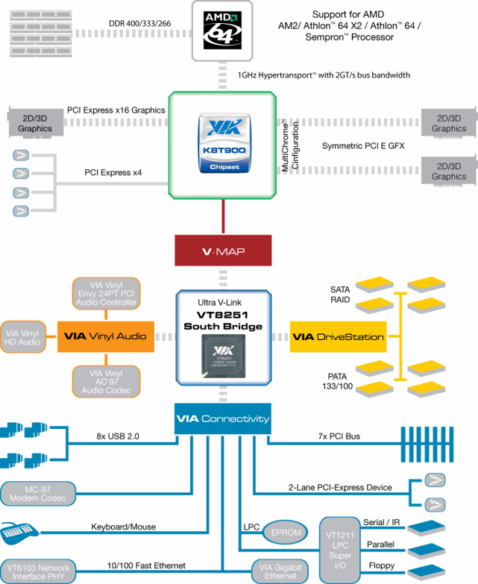
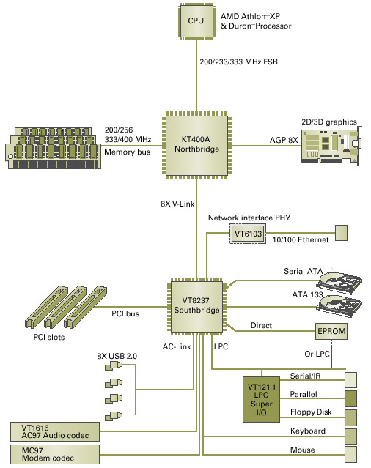
Chipsets

Slide 33
Chipsets
A chipset defines
The processor type
Type and capacity of RAM
What internal and external devices the motherboard will support
Serves as an electronic interface among the CPU, RAM, and I/O devices
Most modern chipsets have two primary chips
Northbridge
Southbridge

Slide 34
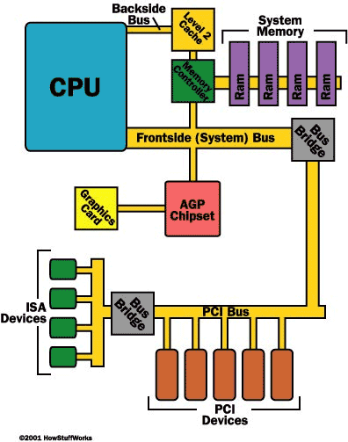
North
South

Slide 35
Chipset
The main components of the computer (processor, memory, cache, etc.) plug into the motherboard and communicate via the chipset.
The chipset determines which type of processor can be used, how fast a processor, how much memory, what type of memory, and so on.
The chipset’s function are typically broken into two sets, one handled by the Northbridge and the other handled by the Southbridge.

Slide 36
Northbridge
The Northbridge handles the high-speed, high-volume data communication between the CPU, cache, memory and AGP (accelerated graphics port). That is it helps the CPU work with RAM (on Intel-based systems)
Since the Northbridge manages the processor-memory interaction (the front-side bus bottleneck), its performance is critical.
The Northbridge determines the FSB speed. Typically the processor operates at a multiplicative factor (the CPU multiplier) of the FSB speed.
It uses synchronous memory, recall SDRAM.

Slide 37
Southbridge
The Southbridge allows communication with a greater variety of slower devices. It connects to the secondary buses – USB, IDE, PS/2, Ethernet.
Sits between expansion slots and EIDE and FDD controllers
Also called the I/O Controller Hub (ICH5) or peripheral bus controller
Since it handles accessing the hard disk, the Southbridge manages a bottleneck of its own, especially for memory-intensive applications.

Slide 38
Chipset Chips
Not always called Northbridge and Southbridge
Intel-based motherboards may refer to them as
Memory controller hub (MCH) for Northbridge
I/O controller hub (ICH) for Southbridge

Slide 39
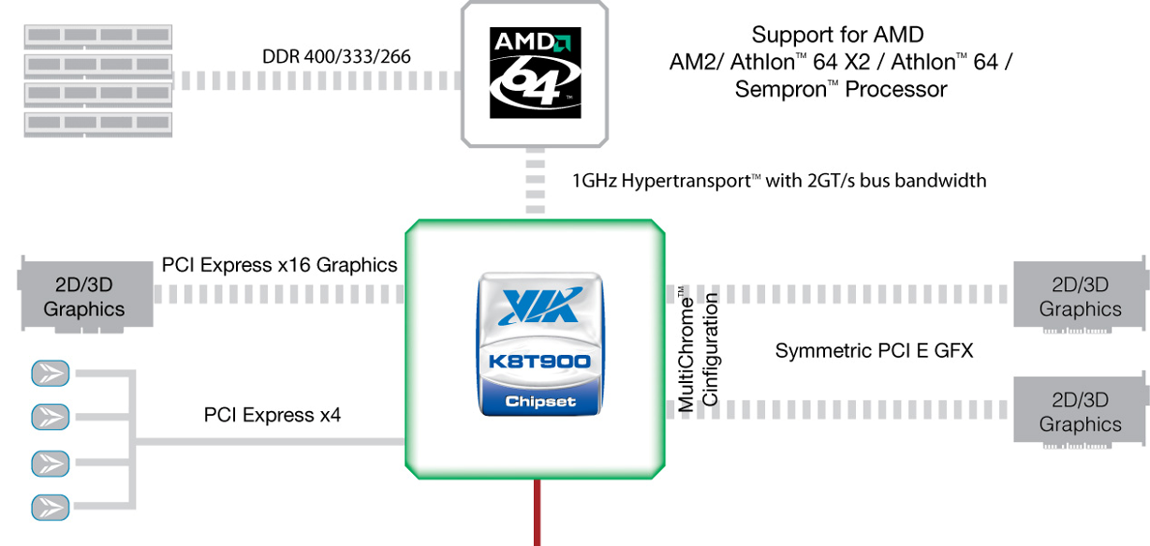
Northbridge
Older Northbridge functions
Worked similar on Intel
Newer Northbridge functions
Only AMD

Slide 40
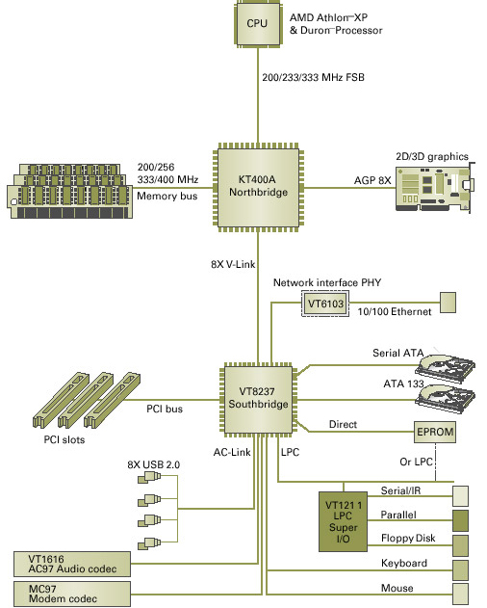
Chipset Schematic
Schematic of an older chipset

Slide 41

Chipset Schematic
Schematic of an modern chipset

Slide 42
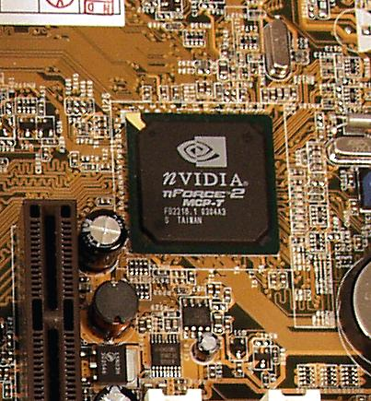
Many Makers of PC Chipsets
Intel
VIA
AMD
SiS
Ali
NVIDIA

Slide 43
Intel Chipsets
Chipset | North-bridge | South-bridge | CPU | RAM
Intel 975X Express | 8295X MCH | 82801 GB ICH, 82801 GR ICH, 82801 GDH ICH | LGA 775 Core 2 Extreme, Core 2 Due, Pentium 4, Pentium 4 with HT, Pentium D | Dual-channel DDR2 up to 8 GB
Intel P965 Express | 82P965 GMCH | P965 ICH8 | All LGA775 | Dual-channel DDR2 up to 8 GB
Intel 9100GL Express | 82910G GMCH | ICH6 or ICH6R | Pentium 4 with HT, Celeron D | DDR up to 2 GB

Slide 44
NVIDIA Chipsets
Chipset | North-bridge | South-bridge | CPU | RAM
NVIDIA nForce-4 | nForce4 | 1 | Athlon 64, Athlon 64 FX, Sempron | 2
NVIDIA SL1 Intel | nForce 570 SL1 | 1 | Intel LGA 775, Core 2 Extreme, Core 2 Duo, Pentium D, Pentium 4, Celeron D | Dual-channel DDR2
NVIDIA nForce 590 SLI AMD | nForce 590 SLI | 1 | Atlon 64, Athlon 64 FX, Athlon 64 X2 | 2
NVIDIA doesn’t make a Northbridge/Southbridge distinction
Athlon has MCC built into CPU so RAM capabilities are determined by CPU, not chipset

Slide 45
VIA Chipsets
Chipset | North-bridge | South-bridge | CPU | RAM
VIA K8 Series | K8T900 | VT8251 | Opteron, Athlon 64, Athlon FX, Sempron
VIA P4 Series | PT890 | VT8237A | Pentium 4, Celeron | SDRAM with ECC, DDR, DDR2 up to 4 GB
Athlon has MCC built into CPU so RAM capabilities are determined by CPU, not chipset

Slide 46
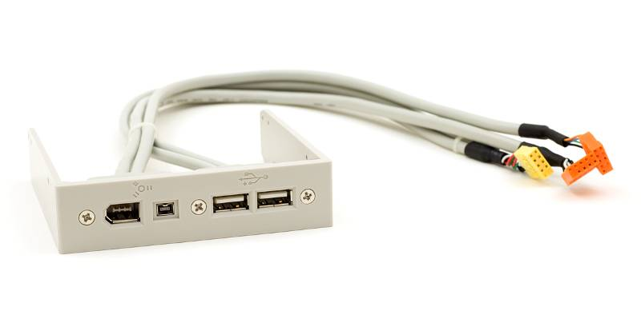
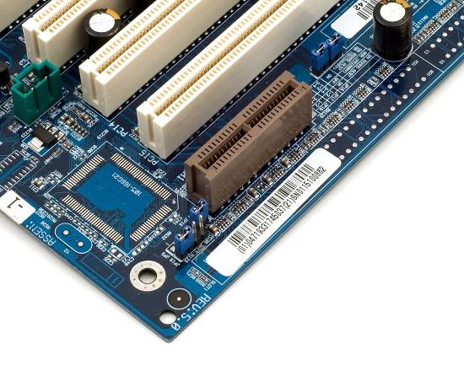
Motherboard Components
Not all chipset features may be supported with ports (for cost savings)
Some motherboards may add features
USB / FireWire
Sound
RAID
AMR/CNR

Slide 47
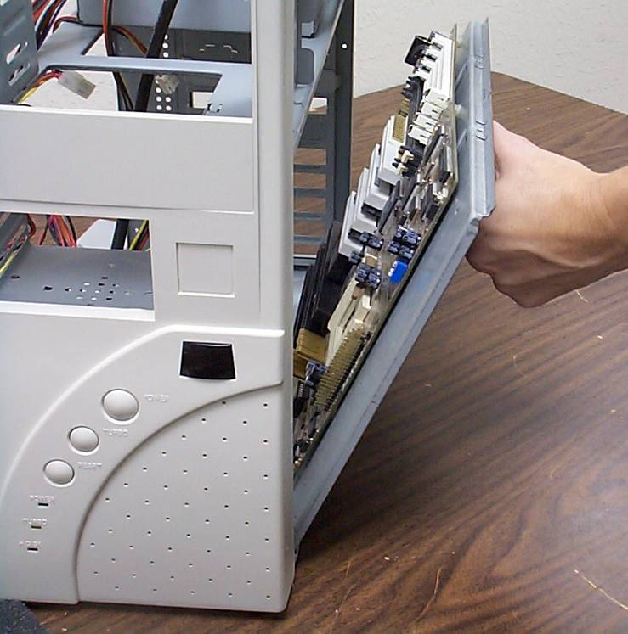
Upgrading and Installing Motherboards

Slide 48
Choosing a Motherboard and Case
Modern motherboards can fit into any type of case manufactured today
But verify that the form factor is supported
Be sure you have access to the motherboard manual
Cases come in six basic sizes: slimline, desktop, mini-tower, mid-tower, tower, and cube
Notes:
Building a Recommendation
Family, friends, and potential clients often solicit the advice of a tech when they’re thinking about upgrading their PCs. This solicitation puts you on the spot to make not just any old recommendation, but one that works with the needs and budget of the potential upgrader. To do this successfully, you need to manage expectations and ask the right questions, so try this!
What does the upgrader want to do that compels him or her to upgrade? Write it down. Some of the common motivations for upgrading are to play that hot new game or to take advantage of new technology. What’s the minimum system needed to run tomorrow’s action games? What does the PC need to make multimedia sing? Does the motherboard need to have FireWire and USB 2.0 built in to accommodate digital video and better printers?
How much of the current system does the upgrader want to save? Upgrading a motherboard can quickly turn into a complete system rebuild. How old is the case? If it’s an AT case, you need to look at a full computer replacement, but if it’s a generic ATX case, you can usually save that much. You’ll most likely want to replace the CPU, so your first decision is AMD vs. Intel. The former gives you more bang for the buck, but the latter offers peace of mind for non-techs. What about RAM? Do you stick with the SDRAM currently in the PC and go for a lower end board that supports the older technology, or buy a mainstream board that uses DDR SDRAM? Will the video card in the system work with the newer AGP slot that the motherboard sports?
Once you’ve gathered information on motivation and assessed the current PC of the upgrader, it’s time to get down to business: field trip time! This is a great excuse to get to the computer store and check out the latest motherboards and gadgets. Don’t forget to jot down notes and prices while you’re there. By the end of the field trip, you should have the information to give the upgrader an honest assessment of what an upgrade will entail, at least in monetary terms. Be honest and you won’t get in trouble.

Slide 49
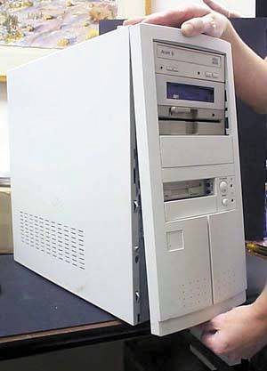
Options to Look for in Case
Removable face
Front-mounted ports
Detachable motherboard mount
Power supply

Slide 50
Removing the Motherboard
Remove all the cards
Remove obstructing drives
Remove the power supply (only if necessary)
Document the position for wires for the speaker, turbo switch, turbo light
Unscrew the old motherboard
The motherboard mounts to the case with small connectors called standouts

Slide 51
Installing the New Motherboard
Install the CPU and RAM on the new motherboard before putting it in the case
Mount the new motherboard in the case
Reinstall the hard drive(s), power supply, and so forth that had to be removed to get the old motherboard out
Insert the power connections and other wires
Test!
Notes:
Discussion Point
Testing the motherboard
When installing a new motherboard, lay out a grounded rubber mat and place the motherboard on it. Set all the jumpers as required. Install the CPU, heat sink, fan, RAM, video card, monitor, and keyboard. There is no need to install a mouse or other cards at this time. Then connect the power supply and power up the board. If it powers up and POSTs, everything is fine and you can finish. If it does not power up and POST, you have to uninstall it all.
Note
It is critical that the motherboard itself does not touch the mounting plate other than at the mounting holes.

Slide 52
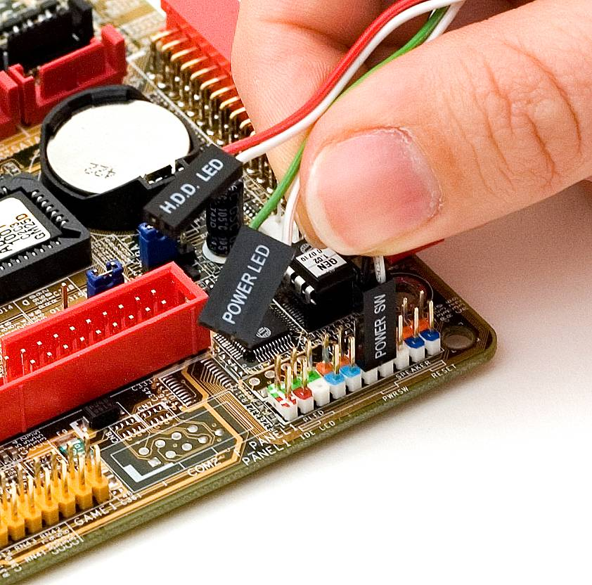
Wires, Wires, Wires
LEDs have positive and negative connections
They work one way; they don’t work the other way
It’s okay to experiment

Slide 53
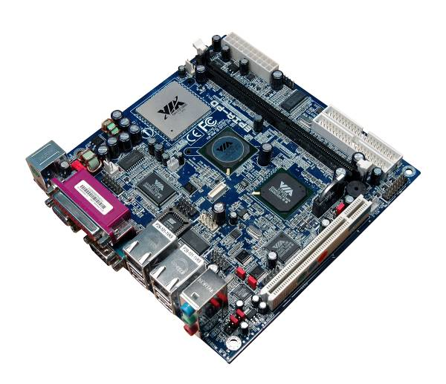
Troubleshooting Motherboards
IT Technician

Slide 54
Troubleshooting Symptoms
Catastrophic failure
System will not boot
Although uncommon, most motherboards will fail (if they’re going to) within the first 30 days due to manufacturing defects, called burn-in failure
Electrostatic discharge is the other most common cause
To fix, replace the motherboard

Slide 55
More Troubleshooting Symptoms
Component failure
Intermittent problems
Examples include a hard drive that shows up in CMOS but not in Windows
Most common causes are electrical surges and ESD
Sometimes a BIOS upgrade may solve this problem if the issue is lack of BIOS support for a newer technology
Fixes include replacing the component with an add-on card or flashing the BIOS

Slide 56
More Troubleshooting Symptoms
Ethereal symptoms
Things just don’t work all the time
PC reboots itself for no apparent reason
Blue Screens of Death
Causes include faulty components, buggy device drivers or application software, slight corruption of the operating system, and power supply problems
Fixes include flashing the BIOS or replacing the motherboard

Slide 57
Troubleshooting Techniques
Isolate the problem by eliminating potential factors
If the hard drive doesn’t work, try a different hard drive or try the same hard drive with a different motherboard
If the new hard drive works, you know it wasn’t the motherboard
If the same hard drive with a different motherboard works, you can suspect the motherboard

Slide 58
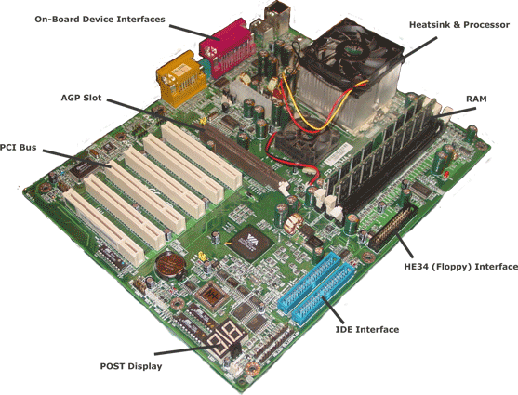
Motherboard

Slide 59
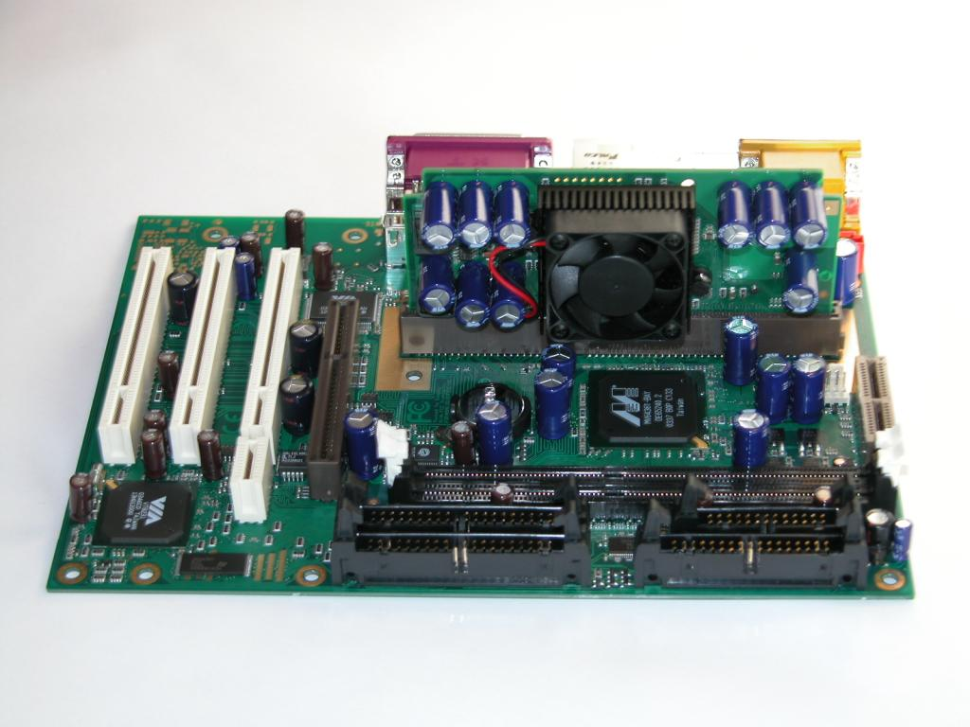
Motherboard

Slide 60
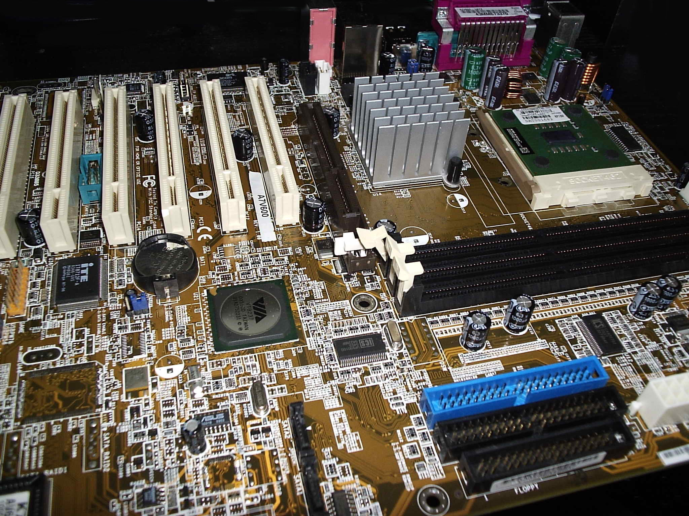
Motherboard

Slide 61
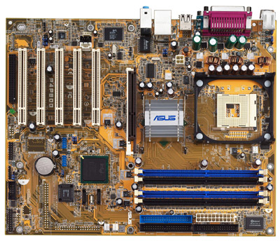
Motherboard
It is the main circuit board that links all the hardware components together.
There are many chips or IC (Integrated Circuit) on the motherboard which contains millions of transistors.

Slide 62
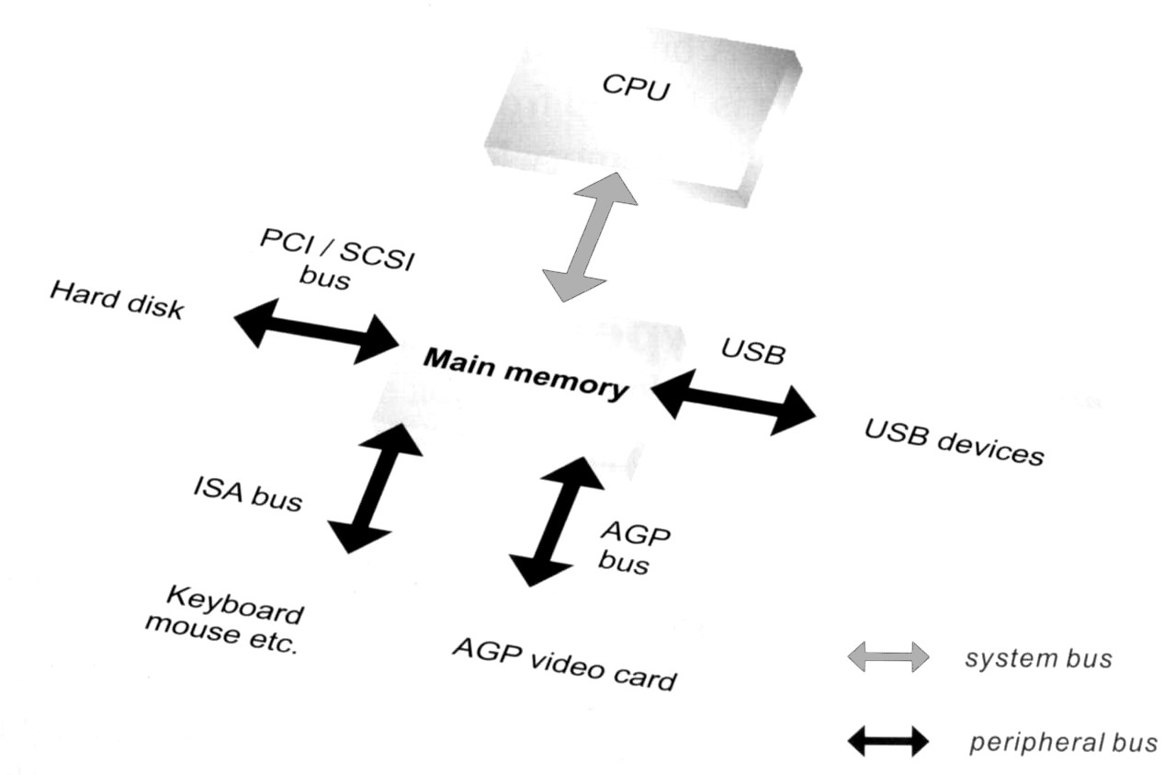
Types of Bus
System Bus
Data transmission between CPU and the main memory via System Bus. It is also known as the Front Side Bus (FSB).
Peripheral Bus
Data transmission between main memory and peripherals via Peripheral Bus.

Slide 63
Bus Lines
Bus line is a physical wiring that connects the components of the computer system on the motherboard.

Slide 64
Bus Width
It is the size of the bus lines.
It determines the number of bits that the computer can transmit at one time (say, one clock cycle).
eg: a 32-bit bus can transmit 32 bits at a time.
the larger the bus width, the faster the transmission.

Slide 65
Examples of Peripheral Bus
ISA Bus
Old sound card
Faded out already
PCI Bus
For most of the interface card like
LAN Card
MODEM
Sound Card
Capture Card

Slide 66
PCI
Peripheral Component Interconnect (PCI)
Intel introduced the PCI bus structure pretty much at the same time it introduced the Pentium.
Like the VESA bus, it interfaces with the Northbridge so it is fast.
It is also self-configuring.
It allows for bus mastering.
It was effectively free (provided automatically by Intel).
It allowed data bursting.
It was scalable.
While introduced by Intel, it works with other processors including Machintosh.

Slide 67
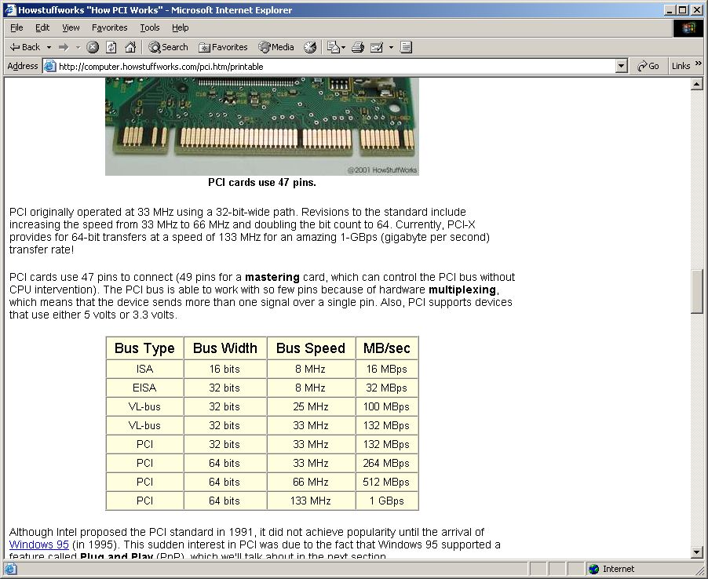
Bus Comparison Table

Slide 68
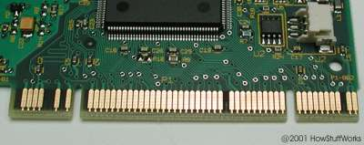
PCI Card Connectors
A PCI card has 47 pins with no bus mastering and has 49 pins with bus mastering.

Slide 69
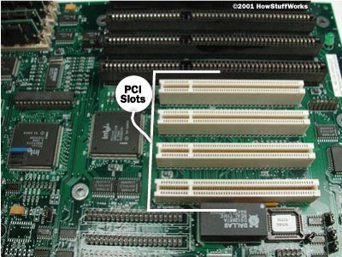
PCI Slots

Slide 70
Putting a card in
Keep the card in its anti-static bag until you are ready to insert it.
Turn off and unplug the PC.
If you don’t have a wrist strap to protect against electrostatic discharge (ESD) then after removing the card from the bag touch the PC’s power supply. The smallest shock could ruin the card or the motherboard.
Insert the card straight in or at most a slight angle.
Screw the card to the box with a connection screw – it keeps the card in place and can help ground it.

Slide 71
Putting a card in (Cont.)
Close the computer, plug it in and start.
You should get a message from the operating system that it has detected new hardware.
It will search for a driver and/or request that you insert a CD with the driver.
You may need to reboot depending on the device.
You should look for the new device in the device manager to make sure there are no conflicts.

Slide 72
Plug and Play
Plug and Play (PnP) is a feature in which the system configures a device automatically rather than the user having to set jumpers and choose resources, etc.
For PnP one needs:
A PnP BIOS
A PnP operating system
A PnP device
All PCI devices are PnP
A device which is not PnP is called a “legacy” device.

Slide 73
How Plug and Play Works
Initially the PnP devices are put on hold and resources are assigned to legacy devices.
Then the system starts querying the PnP devices about the resources each wants.
A PnP device will provide a list of resources it could use.
For example, it would not specify IRQ 3 but rather specify that it could use IRQ 3 or IRQ 5 or IRQ 7.
A file with PnP information, called the Extended System Configuration Data (ESCD), is kept.

Slide 74
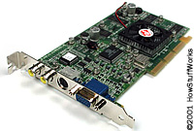
AGP
Specification developed by Intel, even faster than PCI and more directly connected to the Northbridge is the AGP (Accelerated Graphics Port).
It is dedicated to graphics. It will have its own slot to be used only for this purpose.

Slide 75
Examples of Peripheral Bus
AGP Bus
Designed for Display Card only
USB Bus
For most of the peripheral
MP3 Player, Digital Camera
Keyboard, Mouse
Printer, Scanner
etc

Slide 76
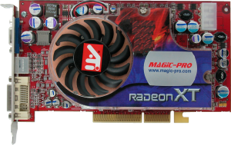
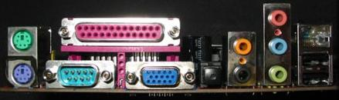
Ports and Interface Cards
The interface between peripheral devices and the CPU.
A port is built on the motherboard while an interface card is inserted into slots on the motherboard.
Sometimes, an interface card may become a built-in function on the motherboard.

Slide 77
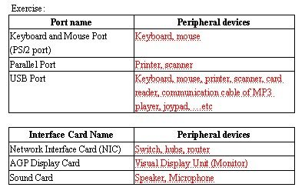

Slide 78
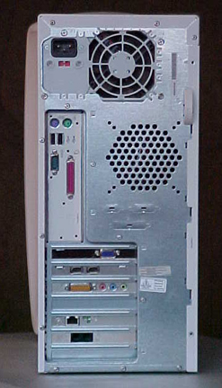
Back of COMPAQ 7000
Input Terminals
Input & Output Terminals
Input & Output Terminals
Input & Output Terminals

Slide 79
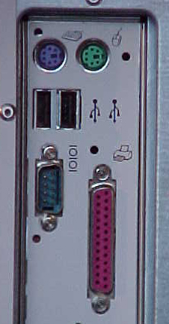
Input & Output Terminals
Most Computers have Icons and Color Coded Connections to help with attaching all the Required and Optional Peripherals.

Slide 80
Input & Output Terminals
Keyboard
Mouse
Universal Serial Bus
Universal Serial Bus
USB
Joystick
Parallel Printer

Slide 81
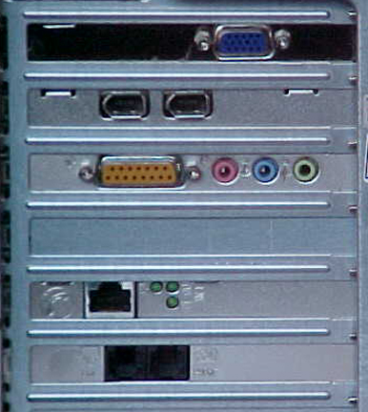
Input & Output Terminals
Monitor

Slide 82
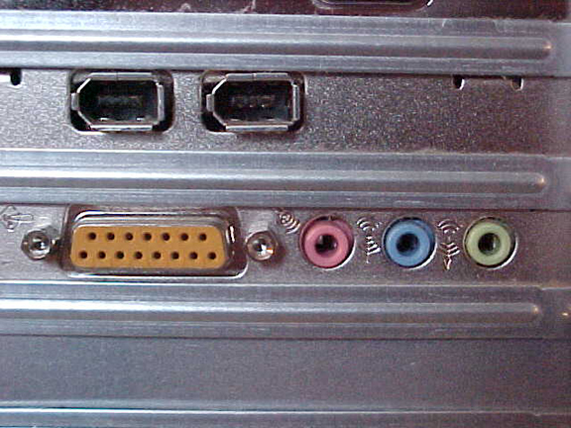
Input & Output Terminals
FireWire IEEE 1394
Audio Inputs and Outputs

Slide 83
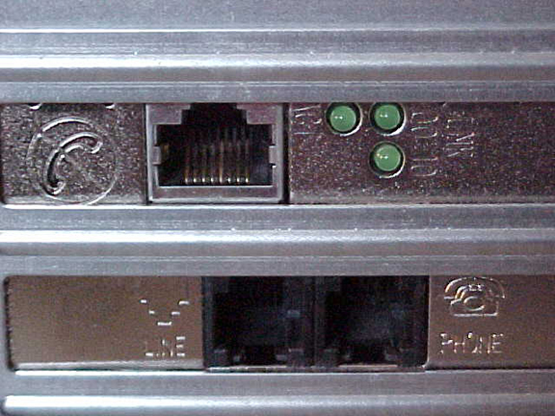
Input & Output Terminals
NOT for Phone
Ethernet Jack
Line for Phone Modem
Output for a Phone

Slide 84
Input & Output Terminals

Slide 85

Inside View

Slide 86

Cards and Drives

Slide 87

















Computer Hardware
RAM
Memory
CPU’s
Processors
Hard
Drives
Floppy
Drives
CD ROM
Drives
Motherboards
Mice
Keyboards
Modems
Video
Cards
Monitors
Printers
Multimedia
Speakers
Sound
Cards
Video
Camera
Backup
Drive
Computer
Cases
Other
Equipment

Slide 88

USB Flash Drives
USB flash drives are compact and easy-to-use devices that are similar in use to your computer hard drive. USB flash drives slip into your pocket, conveniently around your neck or on a keychain for ultimate portable storage.
USB flash drives also are called thumb drives, jump drives, pen drives, key drives, tokens, or simply USB drives.

Slide 89

Computer Hardware

Slide 90




Computer Hardware

Slide 91

Hard Drive Cover Removed

Slide 92

Hard Disk and Read/Write Heads

Slide 93

Disk Track

Slide 94

Adding RAM

Slide 95


Slide 96


COMPAQ 7000

Slide 97

Power Input
AC Power Input
110 Volt / 220 Volt Selection Switch

Slide 98

Back of Drives
DVD DRIVE
CD/RW DRIVE
ZIP DRIVE
FLOPPY DRIVE
HARD DRIVE

Slide 99
Cards and Drives

Slide 100

Expansion Cards
VIDEO CARD
FireWire CARD
1394, i.LINK
SOUND CARD
EITHERNET CARD
MODEM CARD

Slide 101

Power Supply

Slide 102

Heat Sink and Fan on CPU

Slide 103

RAM Cards

Slide 104

What is This?
?
?
?
?
?
?

Slide 105
Battery

Slide 106

Warning

Slide 107

Warning
Static Electricity can Destroy Computer Components

Slide 108
COMPAQ 7000
Now lets look at the Inside of a Computer

